Slide 1


Artificial
Intelligence
Title: TumorTrace: MRI-Based AI for Breast Cancer Detection
Name: Shravani Sanjay More
Theme : AI First
Platform : Infosys Springboard
Mentor: Anurag Sista
01

Slide 2

Project Overview
Objective :
Build a machine learning model to classify breast cancer status (benign or malignant) using MRI images.
Goal :
Aid in the early detection of breast cancer to improve patient outcomes.
Approach :
Utilize deep learning models, data preprocessing, and evaluation metrics to predict tumor status.
02

Slide 3

Problem Statement
The Problem :
Breast cancer is a leading cause of death among women worldwide.
Early detection plays a vital role in improving survival rates.
Manual analysis of MRI scans is slow, expensive, and prone to errors.
The Need :
Automated, accurate, and fast classification of MRI scans to detect cancer earlier and more reliably.
This project aims to develop a machine learning model that can accurately classify MRI images as benign or malignant, thereby aiding in early detection and diagnosis of breast cancer."
03

Slide 4


Overview :
Data collection from MRI images.
Preprocessing for model input.
Model training and evaluation.
Steps :
Data Collection – Obtain labeled MRI datasets.
Data Preprocessing – Resize images, normalize pixel values, data augmentation.
Model Development – Implement deep learning models (VGG16, ResNet).
Evaluation – Assess performance using metrics like accuracy, precision, recall, F1 score, AUC curve, confusion matrix.
Methodology
04

Slide 5


Data Collection and Preprocessing
Dataset :
Dataset contains MRI images labeled as either benign or malignant.
Source of Dataset : Computers in Biology and Medicine
Preprocessing Steps :
Grayscale Conversion: Convert images to grayscale.
Resizing: Resize images to a standard dimension (i.e. 224x224).
Normalization: Normalize pixel values to a range suitable for neural network input.
Augmentation: Apply techniques such as rotation and flipping to augment the dataset.
Handling Class Imbalance: Use techniques like oversampling, under sampling, and class weights.
05

Slide 6

Models Used and Development
Models :
VGG16: A convolutional neural network with 16 layers.
ResNet18 and ResNet50: Deeper architectures using residual connections for improved training.
Model Selection :
VGG16: Chosen for its simplicity and effectiveness in image classification.
ResNet18 & ResNet50: Chosen for better performance in deeper layers with residual learning.
Development Steps :
Initialize pre-trained models.
Fine-tune on breast cancer dataset.
Train and validate models.
06

Slide 7


Evaluation Metrics
Accuracy : Percentage of correct predictions.
Precision : Ability of the model to avoid false positives.
Recall: Ability of the model to identify actual positive cases (sensitivity).
F1 Score : Harmonic mean of precision and recall.
AUC (Area Under Curve) : Measures how well the model distinguishes between benign and malignant tumors.
Confusion Matrix : Table that helps you understand the performance of your classification. It shows the counts of true positives, true negatives, false positives, and false negatives.
07

Slide 8

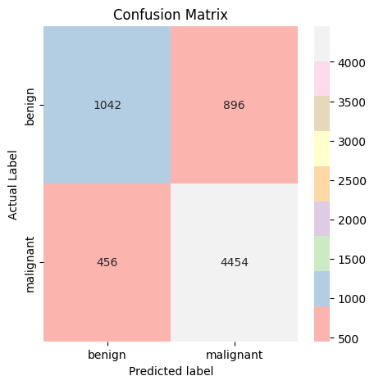
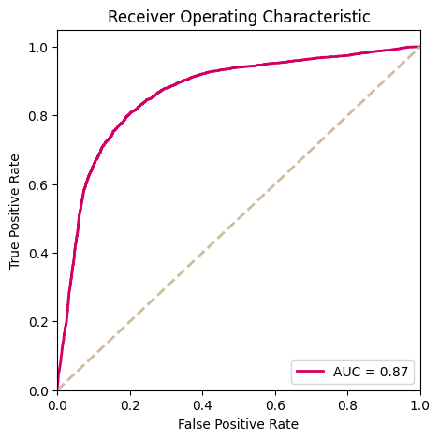
Results and Impact
Model - VGG16
Accuracy: 80%, AUC: 0.8663
Classification Report of Test:
precision recall f1-score support
benign 0.7061 0.4933 0.5808 1938
malignant 0.8213 0.9189 0.8674 4910
accuracy 0.7985 6848
macro avg 0.7637 0.7061 0.7241 6848
weighted avg 0.7887 0.7985 0.7863 6848
Specificity: 1.0000, Sensitivity: 0.0000, AUC: 0.8663
test set: Average loss: 0.9104, Accuracy: 5496/6851 (80.22%)
08

Slide 9
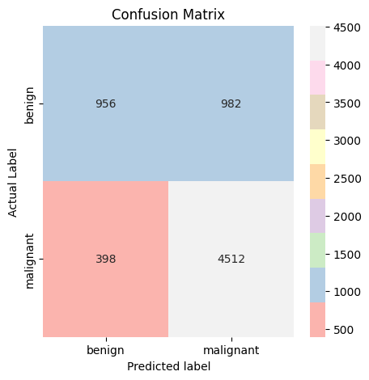
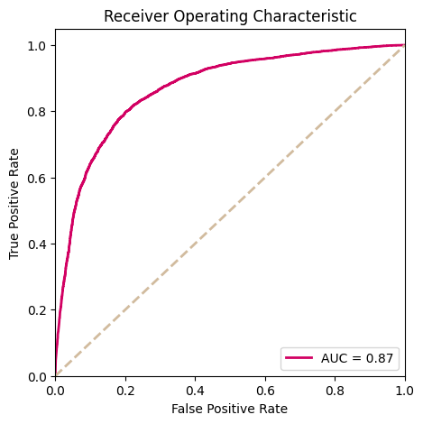
Results and Impact
Model - RESNET 18
Accuracy: 79.81%, AUC: 0.8692
Classification Report of Test:
precision recall f1-score support
benign 0.7061 0.4933 0.5808 1938
malignant 0.8213 0.9189 0.8674 4910
accuracy 0.7985 6848
macro avg 0.7637 0.7061 0.7241 6848
weighted avg 0.7887 0.7985 0.7863 6848
Specificity: 1.0000, Sensitivity: 0.0000, AUC: 0.8692
test set: Average loss: 0.8857, Accuracy: 5468/6851 (79.81%)
09

Slide 10
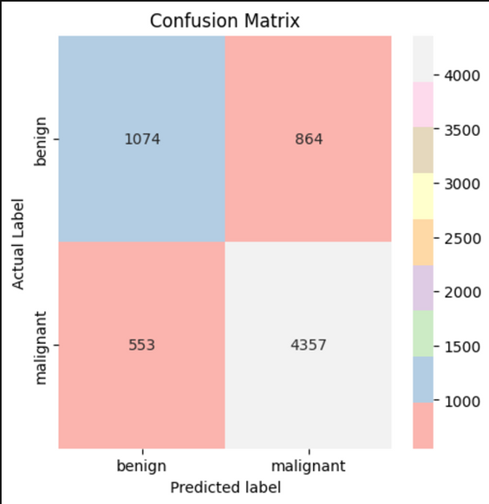
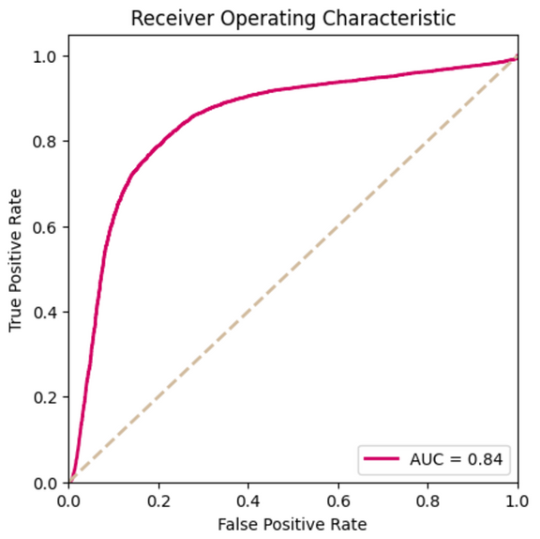
Results and Impact
Model - RESNET 50
Accuracy: 79.27%, AUC: 0.8444
Classification Report of Test:
precision recall f1-score support
benign 0.6601 0.5542 0.6025 1938
malignant 0.8345 0.8874 0.8601 4910
accuracy 0.7931 6848
macro avg 0.7473 0.7208 0.7313 6848
weighted avg 0.7852 0.7931 0.7872 6848
Specificity: 1.0000, Sensitivity: 0.0000, AUC: 0.8444
test set: Average loss: 1.0711, Accuracy: 5431/6851 (79.27%)
Demo video link - https://drive.google.com/file/d/1E0gL3RZe9lzbxL-IJhpHNjt8vdnmRRS9/view?usp=sharing
10

Slide 11
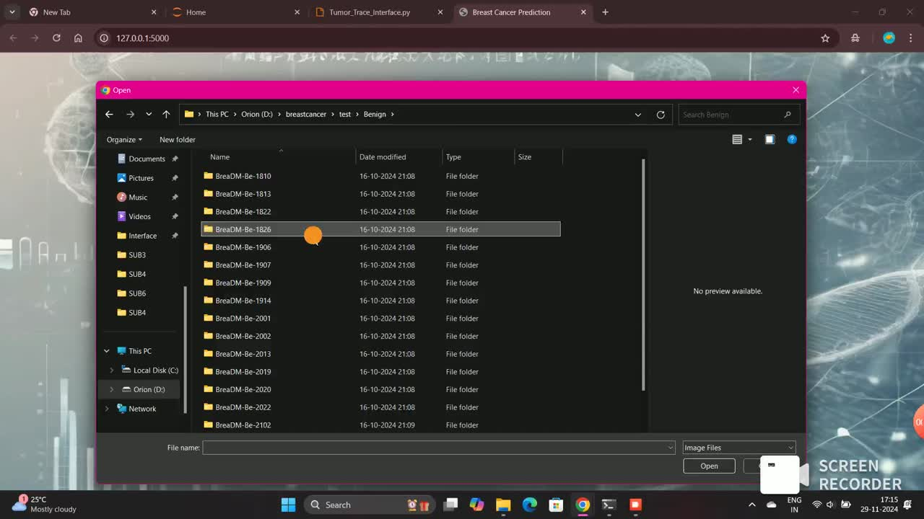

Slide 12


Thank you
12

